Slide 1
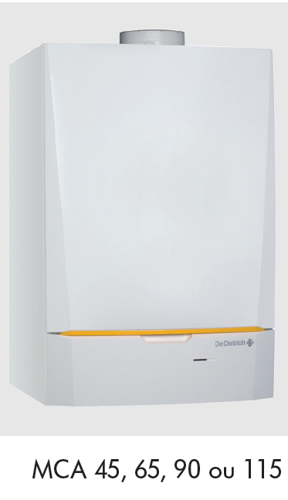
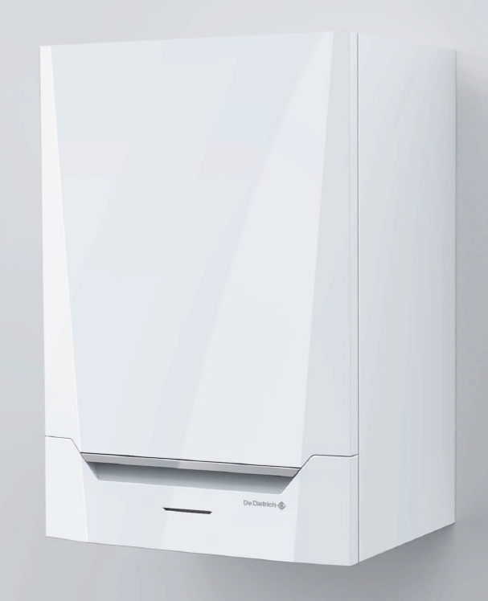
WALL-HUNG GAS CONDENSING BOILERS
New MCA 160 kW

Slide 2
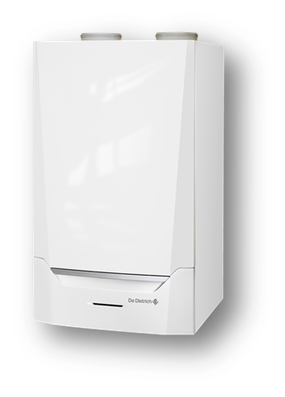
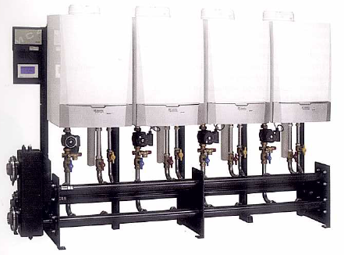
Objectives of the offer
To extend the MCA Pro range with a 160-kW model:
Which is very compact
And can be integrated in a cascade system with MCA PRO 45-115
Max output in cascade up to 1160 kW
To integrate the new electronic platform

Slide 3
Innovens Pro MCA 160
The strong points :
From 114 to 160 kW (50/30 °C)
From 107 to 153 kW(80/60 ° C)
Modulation from 20 to 100%
∆t flow/return until 40°C
Flap cascade integrated
Sound level 55 dB (A)
New control platform
Easy installation and easy maintenance
Full accessibility by the front of the boiler
Internal lighting

Slide 4
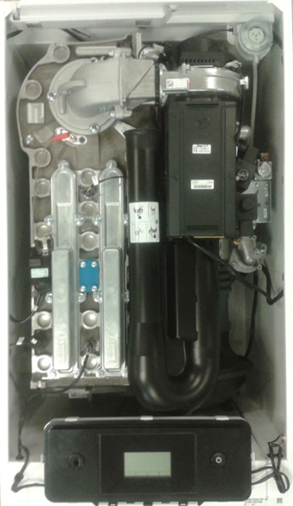
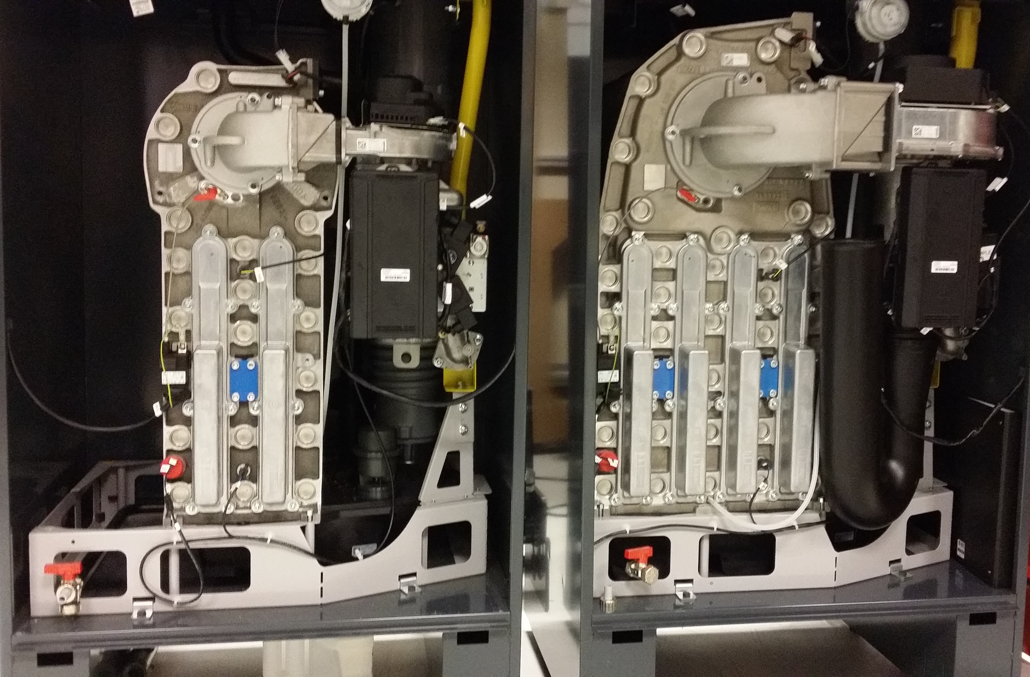
The global PACTA Project
1 WH version of 160kW
4 FSB executions from 160 to 300 kW

Slide 5
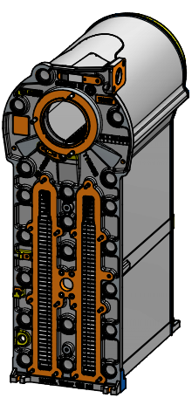
Heat exchanger
Monobloc Aluminium-Silicium (AlSi )
With a sight glass
Very good ratio Output/Volume

Slide 6
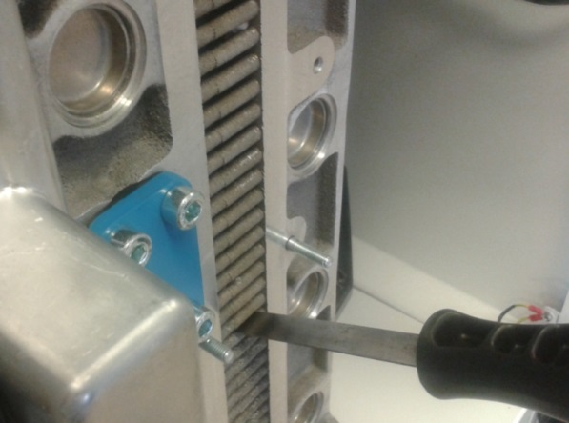
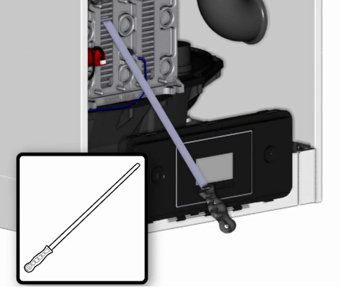
Heat exchanger - Inspection
Cleaning knife (560 mm , like C330)

Slide 7
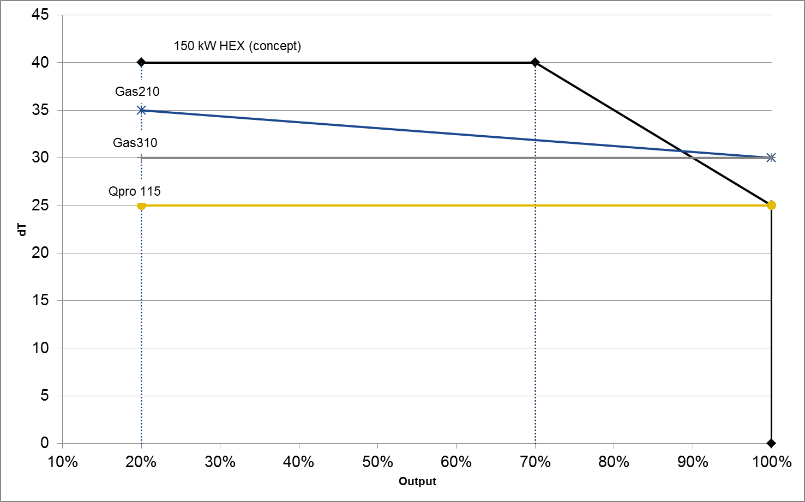
Innovens Pro MCA 160kW
∆t flow/return until 40°C
DHW outputs can be 67% of boiler output
MCA 160
67% soit 102KW

Slide 8
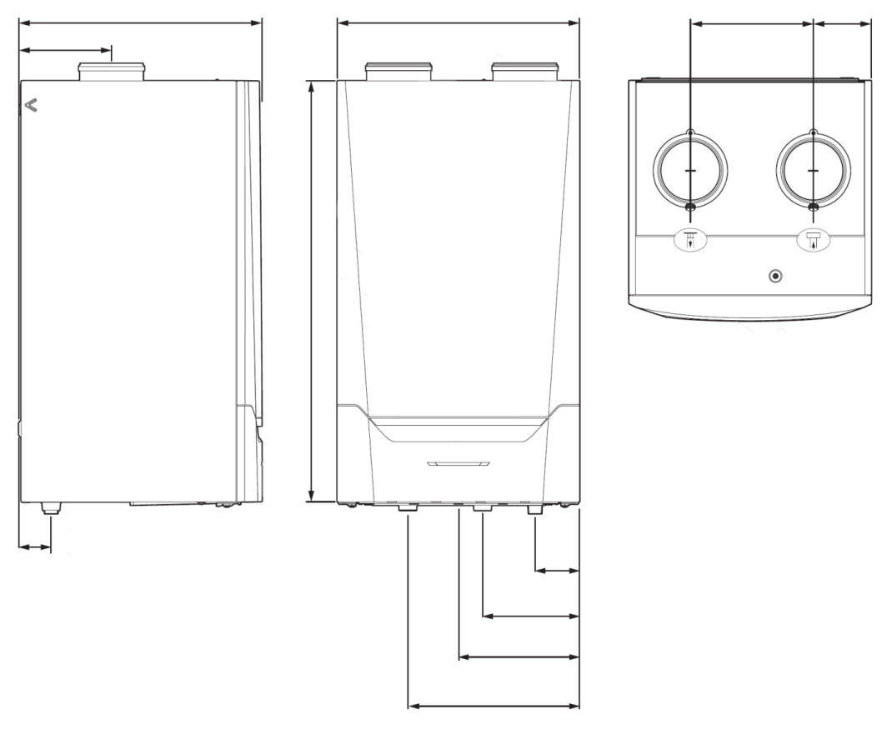
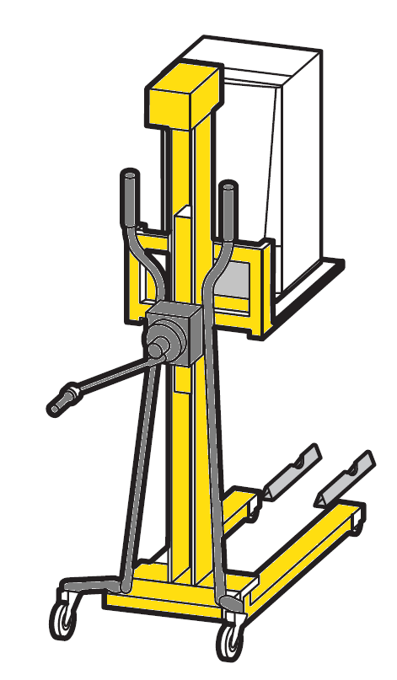
Dimensions and weight
Compact dimensions
Flue gas Ø 150 mm
Air intake Ø 150 mm
Siphon Ø 25 mm
Flow 1¼ inch
Return 1¼ inch
Gas 1 inch
Weight 123kg
(installation with an assistance recommended by De Dietrich)
602
600
305
143
226
air
Flue gas
1045
80
110 Gas
240 Outlet
300 Condensats
425 Return

Slide 9
Two control panel executions
Inicontrol 2
Diematic Evolution
MK2
Application:
Auxiliary boiler in a cascade system
Boiler managed in 0/10V
SCB 01 in std
Application:
3 heating circuits + DHW
Master boiler in a cascade system
SSCB10 in Std

Slide 10
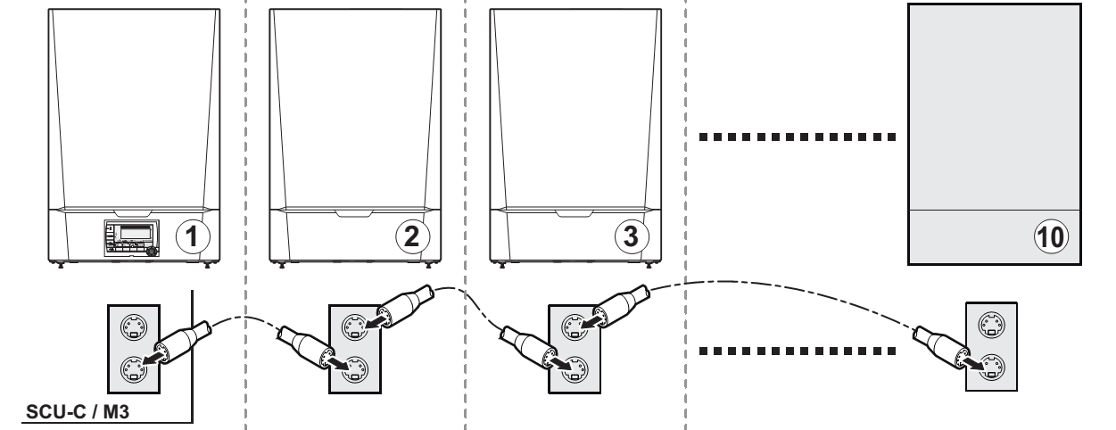
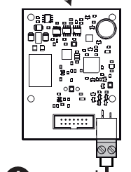
Innovens Pro MCA 160
COMMUNICATION
Only as slave
MCA PRO avec IniControl 2 et SCB-01
OpenTherm (OT) entree on boiler PCB
Current MCA PRO range
Câble BUS
Platine AD 286/287
Master boiler

Slide 11
Innovens Pro MCA 160
COMMUNICATION BUS CAN to BMS systems
MCA PRO avec IniControl 2 et SCB-01
Gateways in developpment for:
- Backnet
- KNX
- Modbus

Slide 12
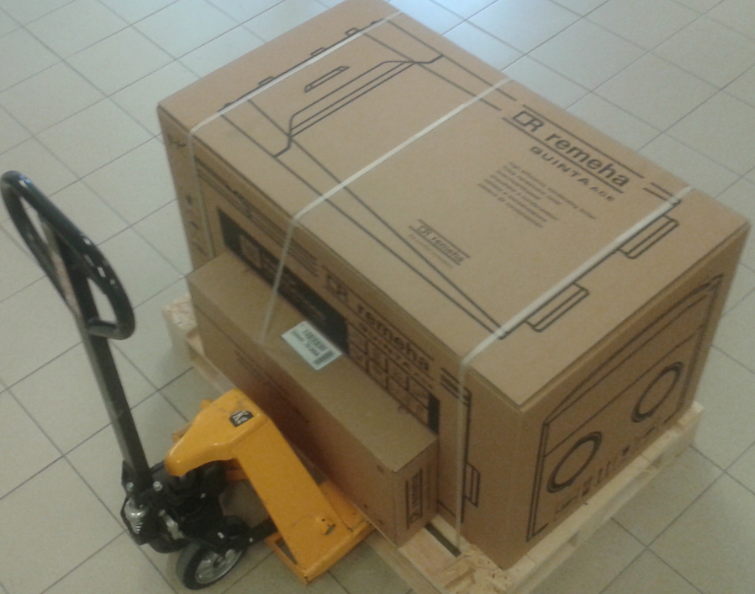
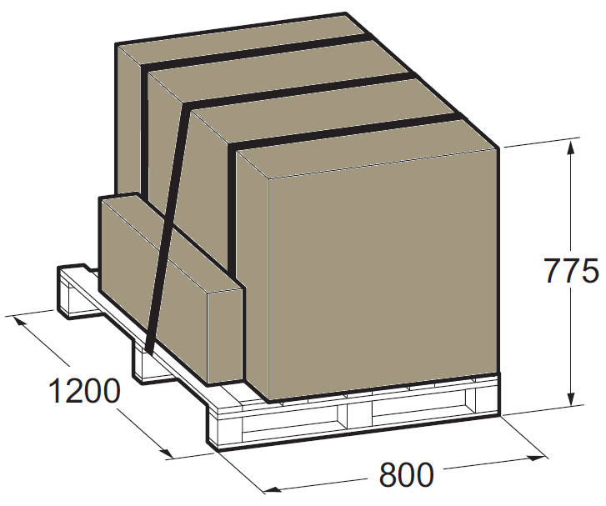
Delivery / Crating

Slide 13
Unpacking
Online instruction

Slide 14
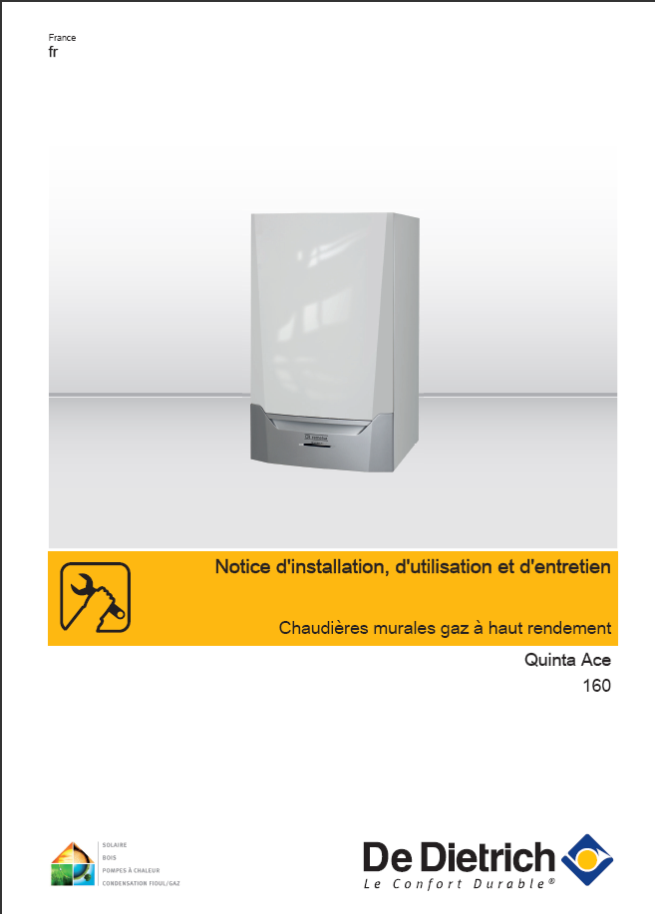
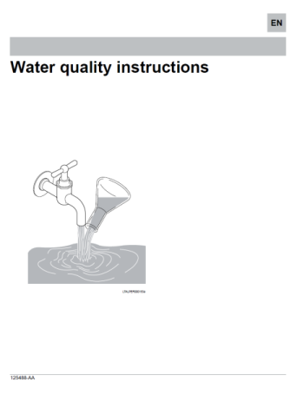
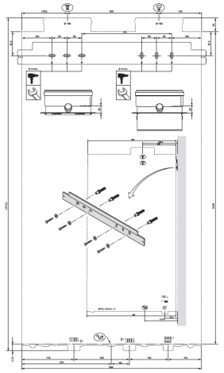
Documentation
Pre installing - Documentation
Manual Innovens pro MCA 160
MK2 MK3 control
Drilling template
Water quality
Sticker gas setting

Slide 15
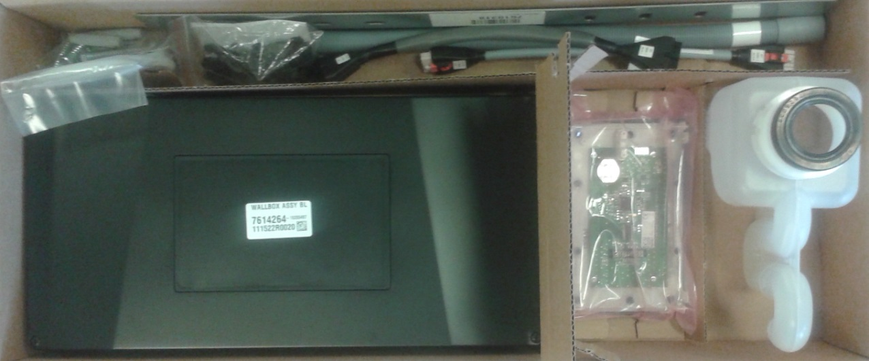
Installation box
Siphon
Hose
Support
Connection cables
HMI (MK2 or MK3)
Connection box
Fixing materials
Cleaning tool

Slide 16
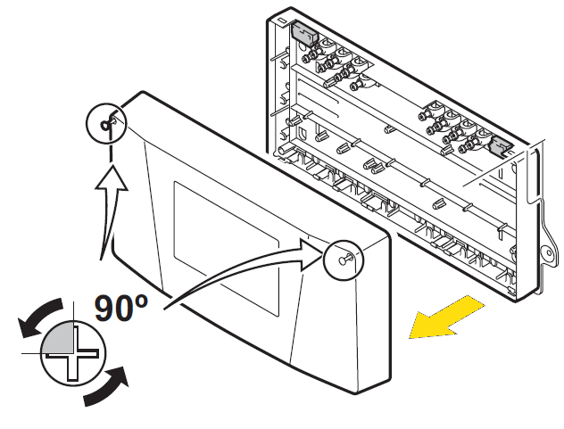
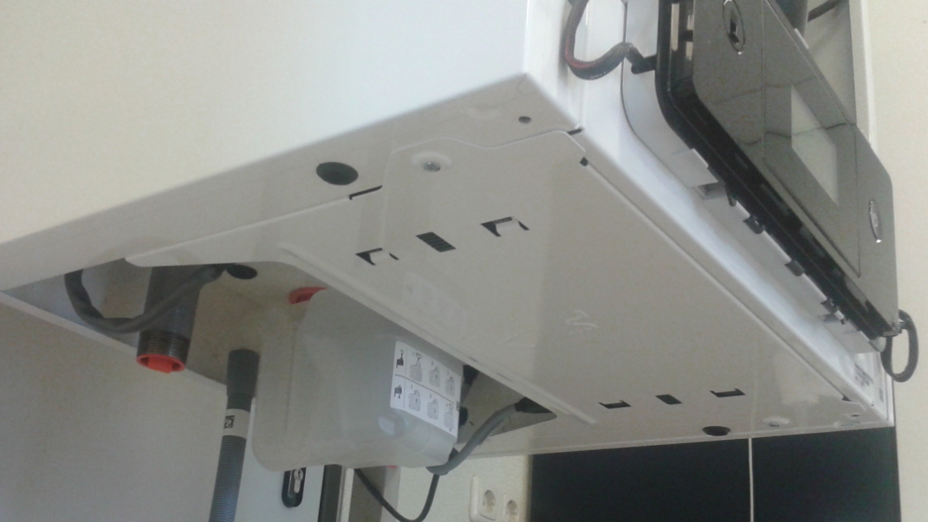
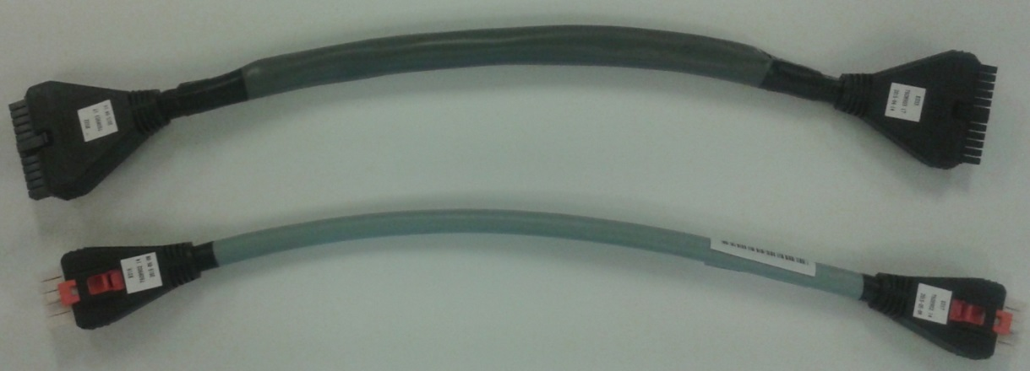
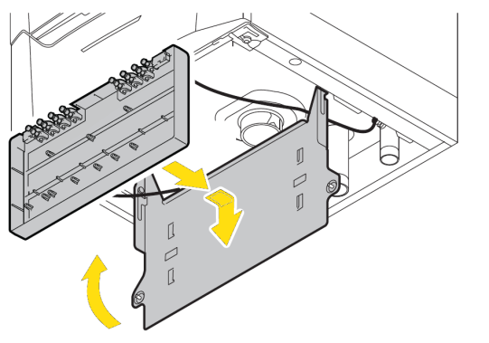
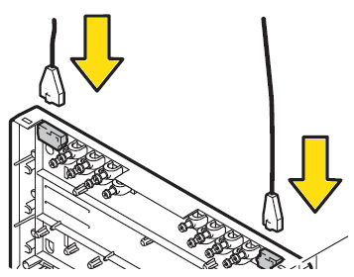
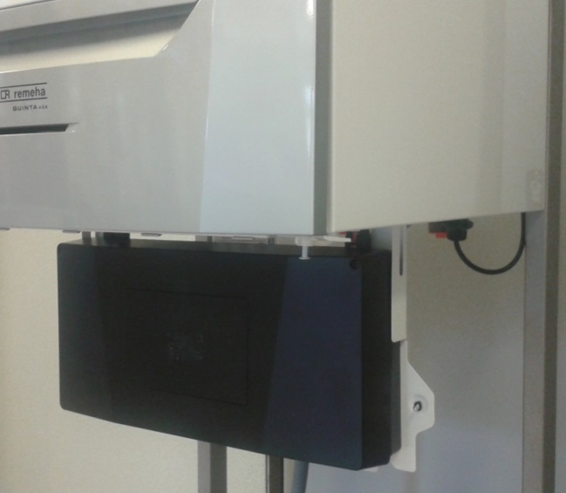
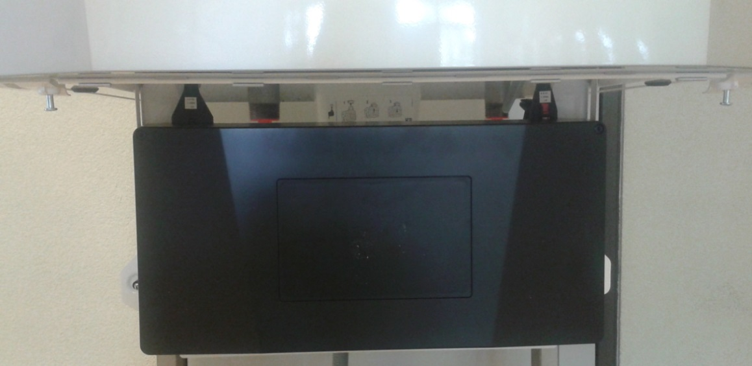
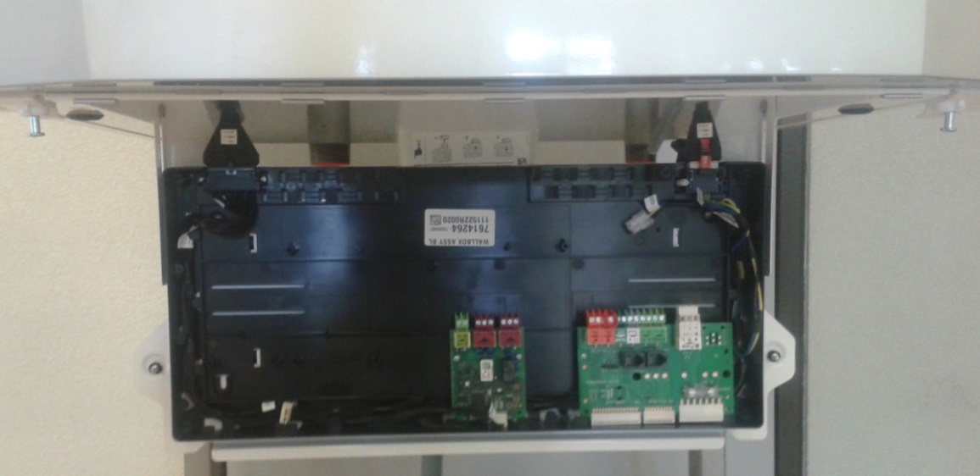
Installing - Connection box
Easy waring

Slide 17
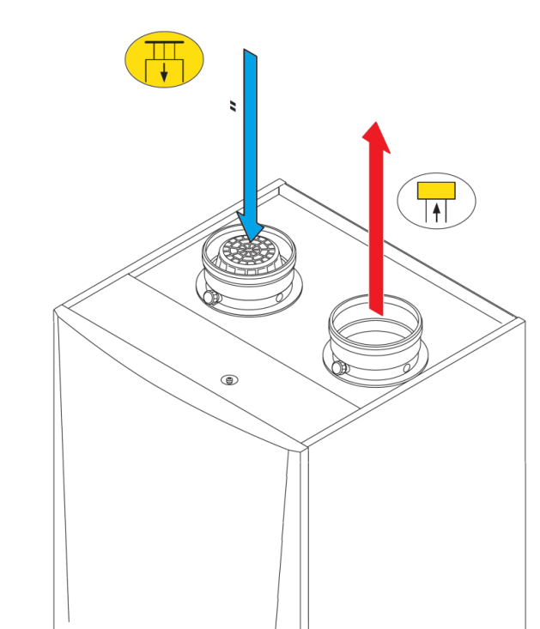
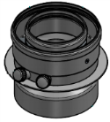
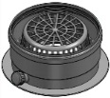
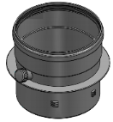
Installing - Connections
Flue gas Ø 150 mm
Air inlet Ø 150 mm
Concentric Excentric
Ø 110/150mm (standard FR )
option

Slide 18
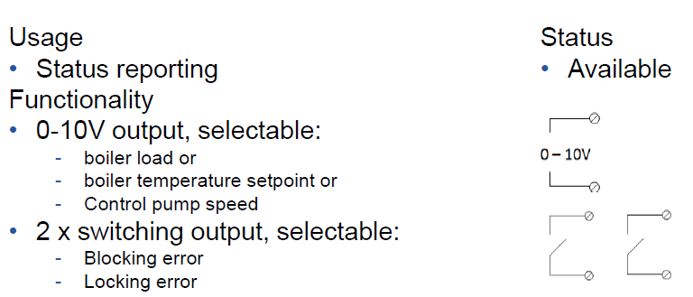
Standard regulation with inicontrol2
SCB 01

Slide 19
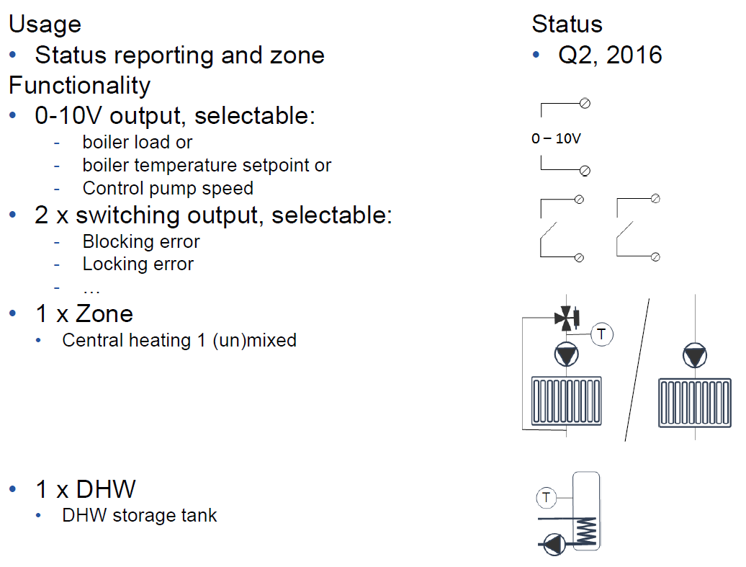
Options Regulation inicontrol2
SCB 02

Slide 20
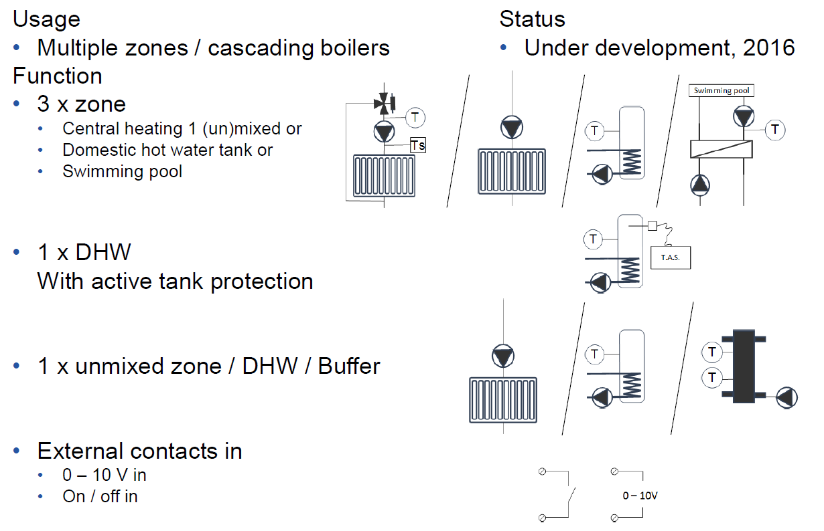
Standard regulation with Diematic Evolution
SCB 10

Slide 21
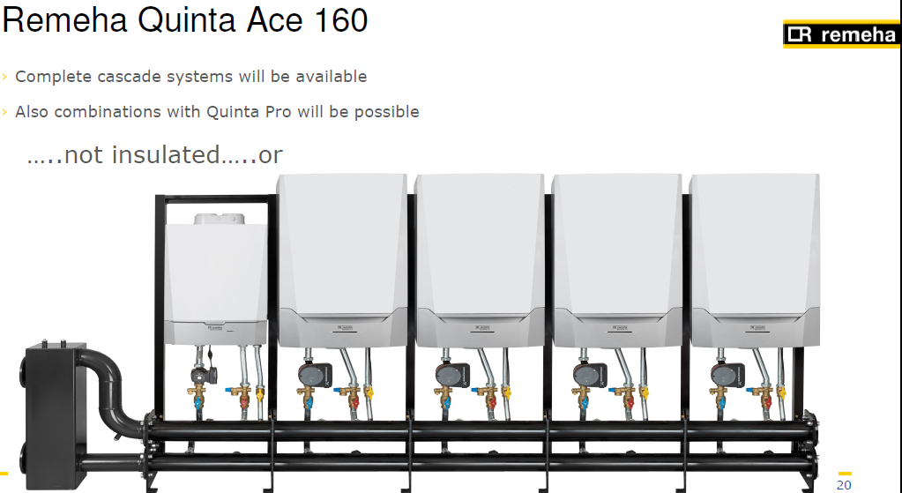
Cascade kit
Cascade kit for MCA 160
compatible with the others « MCA 15,25,35,… » without insulation or…

Slide 22
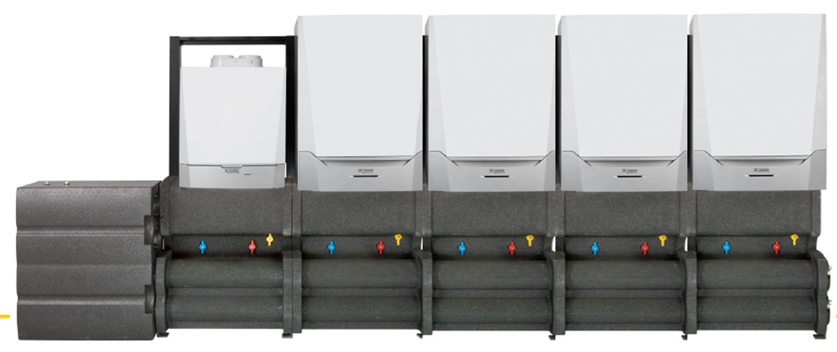
Cascade kit
With insulation

Slide 23
Launching
- March 2017 with Diematic Evolution

